Slide 1
jQuery - introduction (Day 4)
Viktoras Lava www.viktoraslava.lt

Slide 2

What is jQuery?
jQuery is the most popular JavaScript library for manipulating the HTML document. It was founded in 2006 and it’s still actively updated.
Around 73.3% of websites are using jQuery world-wide.

Slide 3
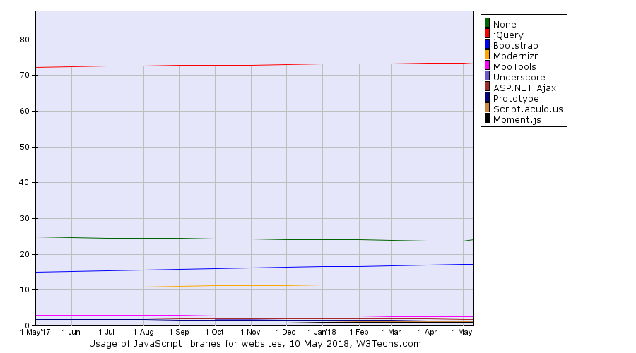

Slide 4
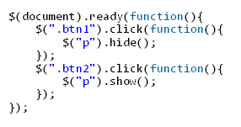
1.1 Why use jQuery?
The main purpose of jQuery is to make much easier to use JavaScript on your website.
It takes a lot of of common tasks that require many lines of JavaScript code to accomplish, and wraps them into methods that you can call with a single line of code.
Example

Slide 5
1.2 Why use jQuery?
Free (MIT license)
Lightweight
Simplicity
Compatibility (works everywhere)
Easy to learn
Write less, do more

Slide 6
1.1 How to start using jQuery
<script src="https://ajax.googleapis.com/ajax/libs/jquery/3.3.1/jquery.min.js">
</script
To start using jQuery you need to load it into your document . You can do that with the <script> tag, inside the <head> tag.
You can load the jQuery locally or from the Google CDN server - there’s no huge difference in terms of performance.

Slide 7
1.2 How to start using jQuery
$(document).ready(function(){ // This is the first function to be called when the page loads. // jQuery code, event handling callbacks here });
After adding jQuery to your document you can start writing jQuery code in your script.js file.
However, you need to wrap your code inside the document ready event (similar to window.onload).
Example.

Slide 8
Method list
on()
css()
addClass()
removeClass()
toggleClass()
hasClass()
animate()
scrollTop and offset()
Documentation
remove()
parent()
find()
preventDefault()

Slide 9
Questions?

Slide 10
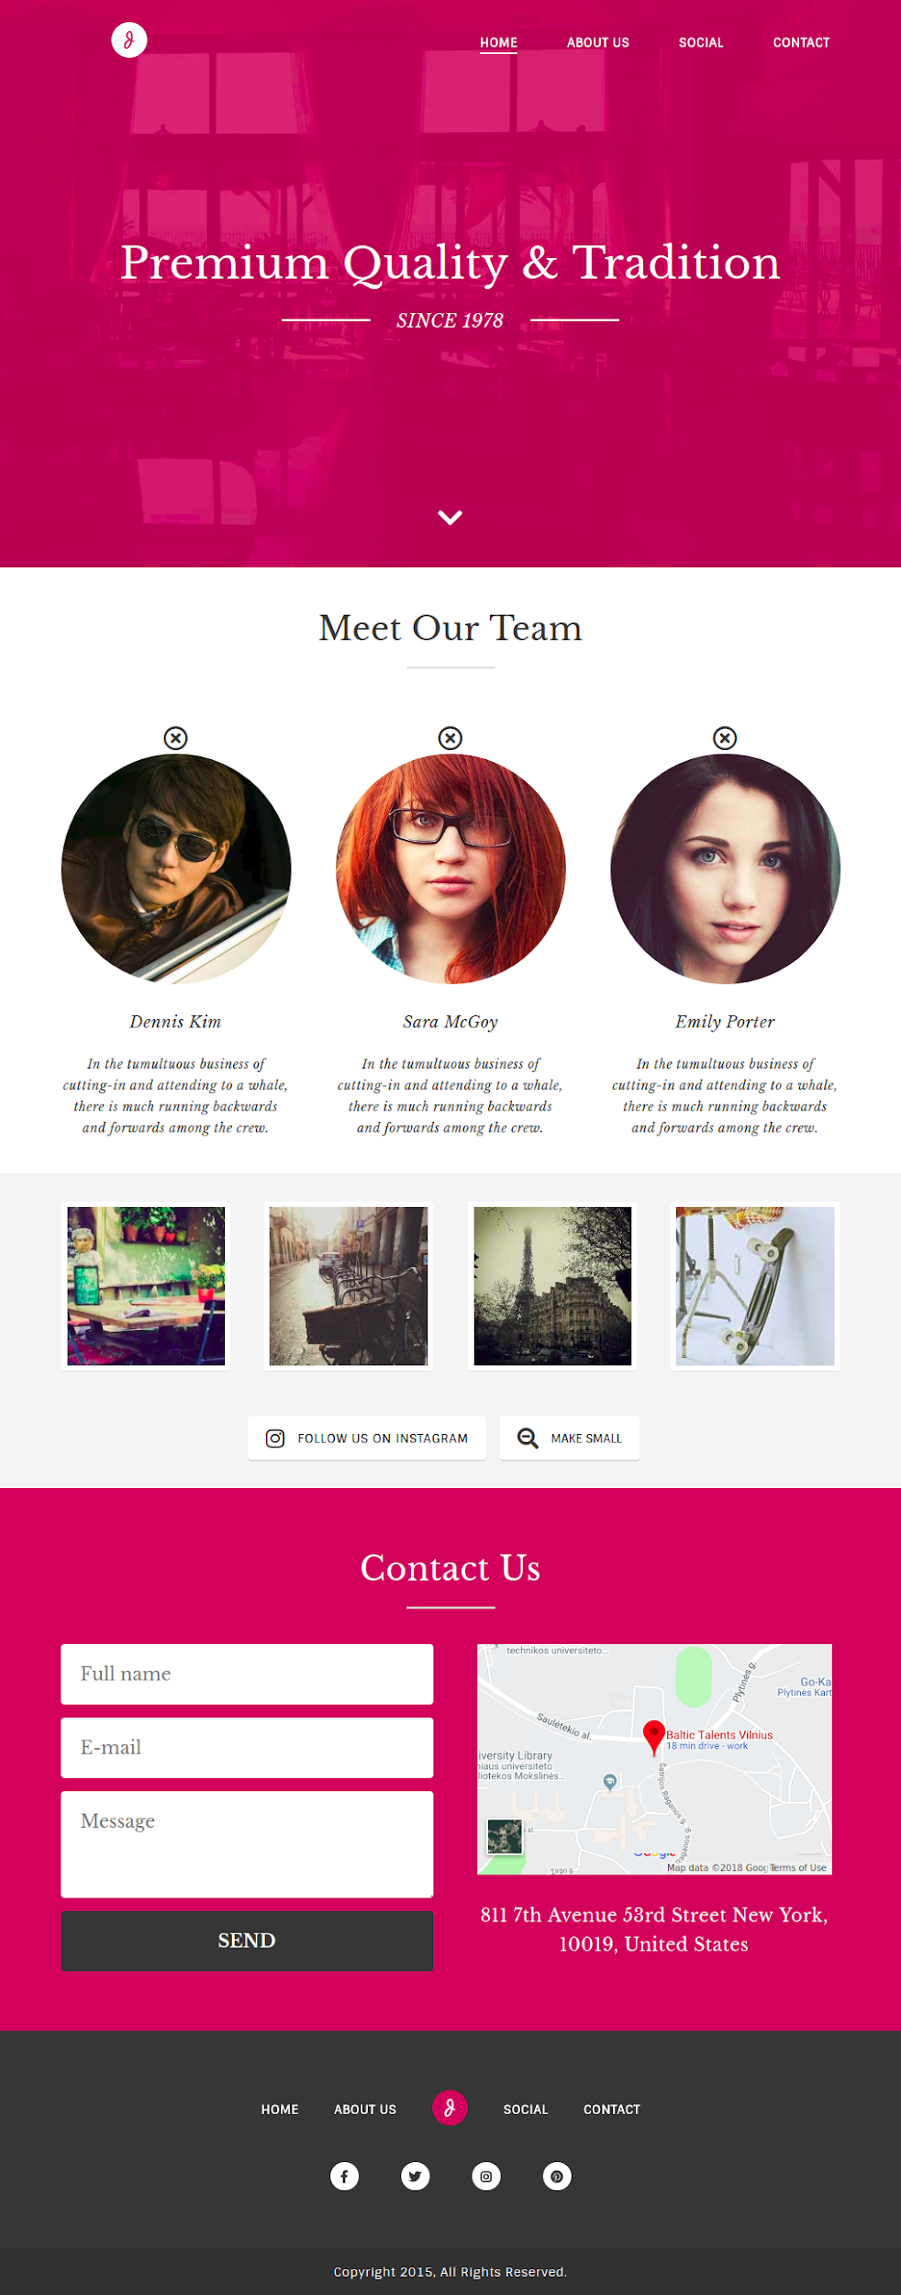
Homework
You need to modify the old website with jQuery.
There are 6 tasks in the google drive. You will find instructions under /js/script.js file. 2 tasks are extra.
Watch videos in the reference slide
Website should work and look like in the example

Slide 11
jQuery introduction
https://www.youtube.com/watch?v=Pt49y1gm0jw
jQuery selectors, animations, filters
https://www.youtube.com/watch?v=v-RC3kJCL4c
jQuery classes, image swap, methods
https://www.youtube.com/watch?v=OqF0kjNwDSI
jQuery event binding, DOM traversal
https://www.youtube.com/watch?v=WVvdw-f4Ygo

